Slide 1

PlatyPS v1.0
Microsoft.PowerShell.PlatyPS A new way to create PowerShell documentation

Slide 2

PlatyPS v1.0
PlatyPS v1.0
Microsoft.PowerShell.PlatyPS
A new way to create PowerShell documentation

Slide 3
Brief history of PowerShell Help
Introduced in PowerShell v2.0
Comment-based help
External help (MAML)
Updated in PowerShell 3.0
Added Update-Help (HelpInfoUri)
Added Get-Help -Online (HelpUri)
Added Get-Help -ShowWindow

Slide 4
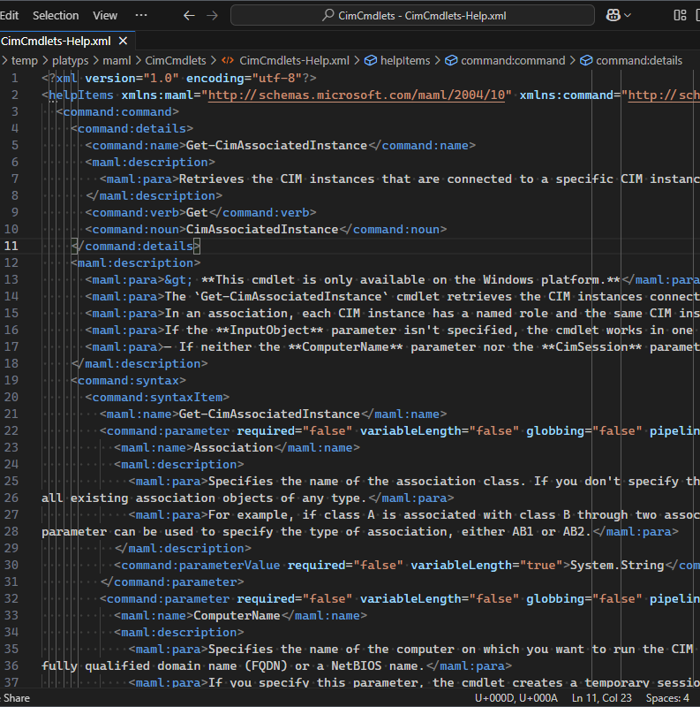
What is MAML?
Microsoft Assistance Markup Language (MAML)
Structured (XML) content intended to replace the old CHM format in Windows
Enables transformation for different presentation formats
The only way to provide help for compiled commands
Can be used with or in place of comment-based help
Shortcomings
XML/MAML is difficult for authoring
MAML is not documented
MAML has been abandoned
Sandcastle (software) - Wikipedia

Slide 5
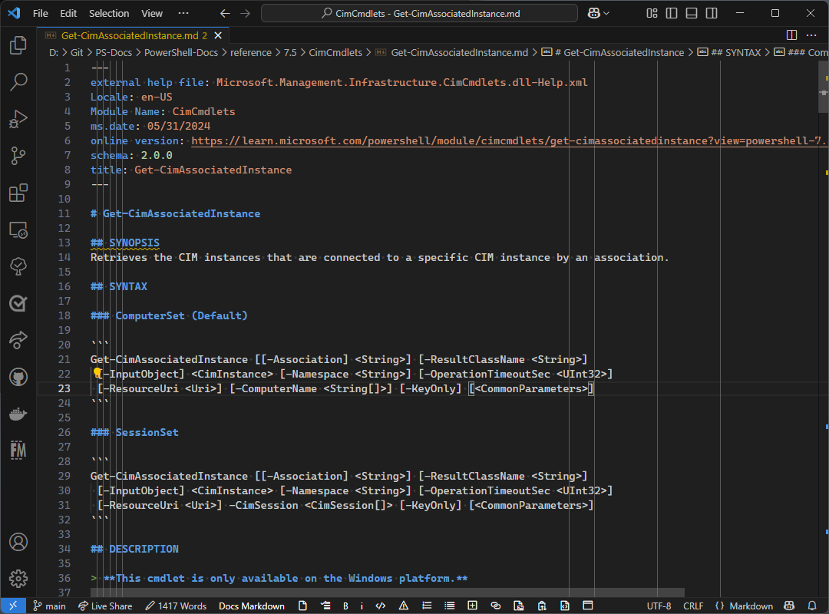
How to solve the authoring problem
platyPS - PowerShell module to create documentation in markdown
Creates markdown files for each command in a module
Markdown is easier to edit and author
Converts markdown to MAML

Slide 6
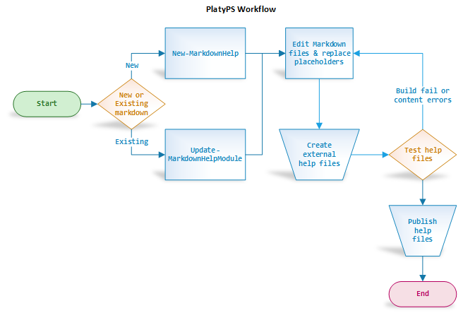
Limitations of (old) platyPS
Monolithic workflow
Only supports file operations – no pipelining
Non-standard Markdown & YAML
Weak object model
Incomplete metadata discovery
Incomplete representation of command data
Missing features
Slow performance
Script-based commands
Hackathon project that escaped into production

Slide 7
Microsoft.PowerShell.PlatyPS v1.0.0
Complete rewrite in C#
Strong object model
Fast - Pipeline-able commands
Increases the complexity of the workflow but provides flexibility and speed
Uses standard libraries for Markdown and YAML
Improved MAML rendering
Built for Microsoft’s needs and scale
Still a work-in-progress
Built for us but it works for your docs too

Slide 8
How to create help using PlatyPS v1
Import
Import the module to be documented
Create
Create Markdown files for the module
Edit
Edit the Markdown files to fill in placeholders
Convert
Convert Markdown to MAML
Publish
Publish MAML files

Slide 9

Demos
New object model
Typical workflow for
New module
Update module
Create MAML
Performance example
Tool example – test docs using object model

Slide 10

Future roadmap?
GA plans – no target date
Driven by internal partner requirements
Shipping on quality
Add more metadata discovery (e.g. validation attributes and values)
Conversion to other formats (HTML, HelpInfo objects?)
Localization support
Support for more structured formats
Can we make Help use markdown-based content?

